Slide 1
Problems of Drinking Alcohol
EAP 02 KIM HYUNUK

Slide 3
Objective
1. Physical Problem
2. Mental Problem
3. Christian View of Alcohol
4. Opposite Opinion

Slide 4
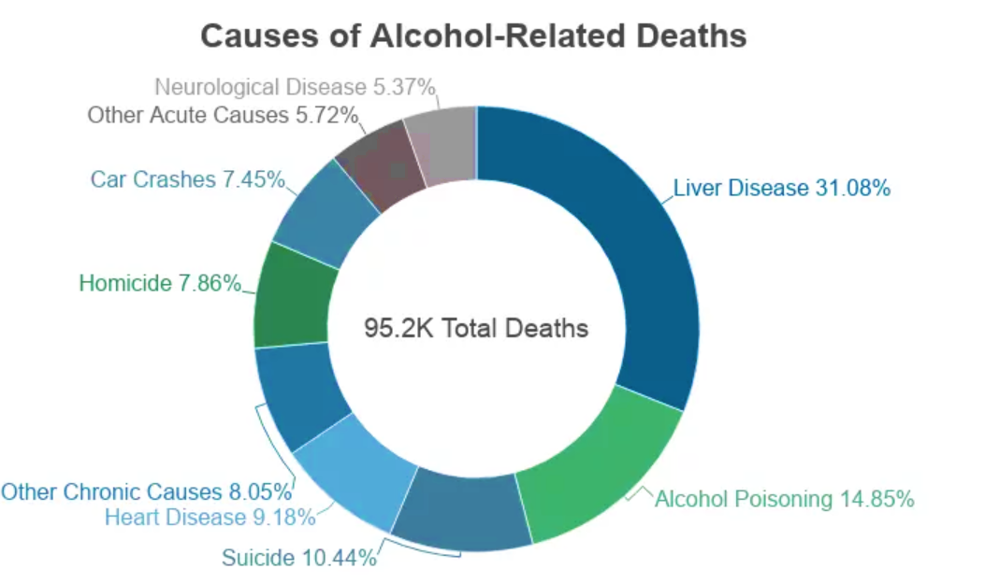
Physical Problem
(NCDAS, 2022)

Slide 5
Physical Problem
“ Alcohol interferes with the delivery of oxygen and optimal nutrition to developing baby. ”
(Mayo Clinic, 2018)

Slide 6


Mental Problem
Dopamin
Serotonin

Slide 7
Mental Problem
“ Some of the most potent antidepressants
are working to inhibit serotonin transporter ”
(National Library of Medicine, 1997)

Slide 8

Mental Problem
Unnatural Signal

Slide 9
Christian View of Alcohol
“ Do not get drunk on wine, which leads
to debauchery. Instead, be filled
with the Spirit ”
(Ephesians 5:18)

Slide 10
Christian View of Alcohol
Q) What is “Do not be conformed”
meaning in Romans 12:2

Slide 11

Opposite Opinion
“Alcohol alters our social or cognitive abilities, allowing us to perform more effectively in social circumstances.”
(NIA, 2016)

Slide 12
Conclusion
Alcohol assumption is physically, mentally, and religiously harmful

Slide 13
References
Davis, K. F. (2018, February 28). What effects does alcohol have on health? Medical News Today.
https://www.medicalnewstoday.com/articles/305062
Fetal alcohol syndrome - Symptoms and causes. (2018, January 10). Mayo Clinic. https://www.mayoclinic.org/diseases-conditions/fetal-alcohol-syndrome/symptoms-causes/syc-20352901
David M. Lovinger, (1997, February 22). NCBI - WWW Error Blocked Diagnostic. National Library of Medical. https://www.ncbi.nlm.nih.gov/pmc/articles/PMC6826824/
English Standard Version Bible. (2001). ESV Online. https://esv.literalword.com/
Monga, A. (2021, May 11). Alcohol: Benefits, Risks, and How Much Is Too Much? Gleneagles Hospital. https://www.gleneagles.com.sg/healthplus/article/alcohol-risks-benefits
Alcohol abuse statistics [2022]: National + state data. NCDAS. (2022, April 6). Retrieved June 13, 2022, from https://drugabusestatistics.org/alcohol-abuse-statistics/

